Slide 1
Facility Layout
Dr. Narpat Ram Sangwa
Assistant Professor
Operations & Supply Chain Management
IIM Sirmaur

Slide 2
Classroom rules
Punctuality: At least 5 minutes before the class timing
Mobile & laptop: No use
Class attendance: 100% mandatory
Query rule: Wait for the turn to ask question
Pre-readings & assignments: if not read or done, please don’t enter in the class
Presence: No breaks; remain in the classroom for complete 90 minutes
Sitting Arrangement: Always sit as per the sitting arrangement and use your name tags

Slide 3
Learning Objectives
What is meant by process?
What are various types of processes?
What are different types of layouts?
How process layout can be designed?
How product layout can be designed?
What are various types of hybrid layouts?

Slide 4
Process
A process is a set of related tasks with specific inputs and outputs. It creates value to customer, shareholder, or society.
Process selection: Refers to deciding on the way production of goods or services will be organized.
It has major implications for.
Capacity planning.
Layout of facilities.
Equipment.
Design of work systems.
Notes:
A process is the overarching set of activities from input to output, representing the "what" of a goal, such as manufacturing a product. An operation is a specific, focused step or action within that process, describing the "how" it's done, like molding a part.

Slide 5
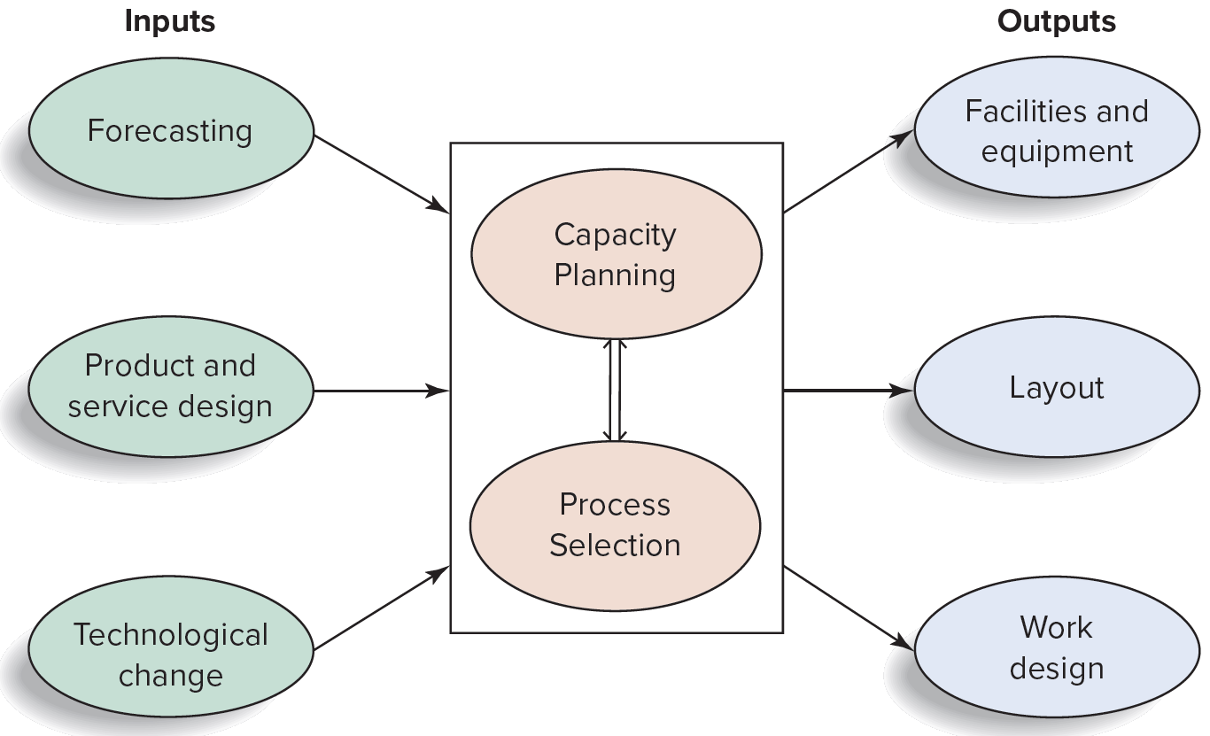
Process Selection and Capacity Planning in System Design

Slide 6
Process Selection
Two key questions in process selection:
How much variety will the process need to be able to handle?
How much volume will the process need to be able to handle?

Slide 7
Process Types
Ongoing operations:
Job Shop
Batch
Repetitive
Continuous Flow
Projects: It is used for work that is nonroutine, with unique set of objectives to be accomplished in a limited time frame.

Slide 8
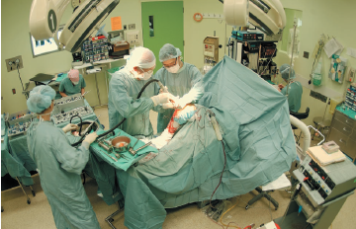
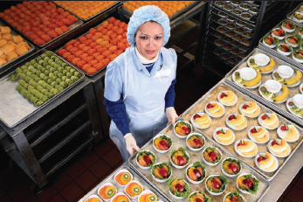
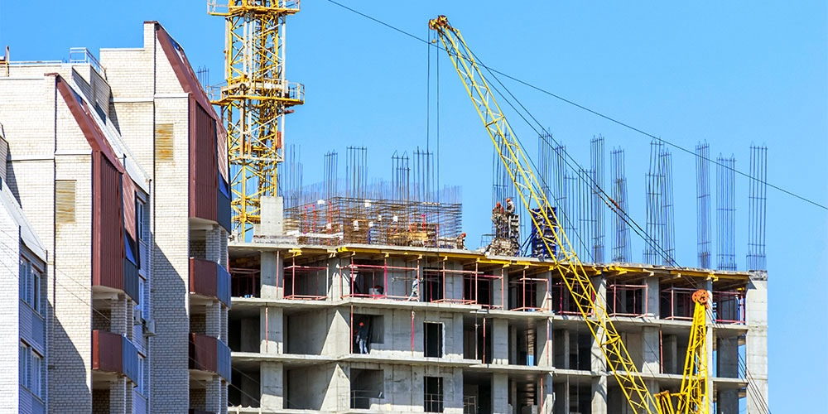
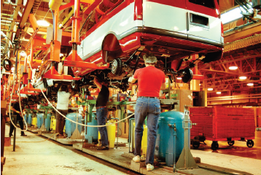
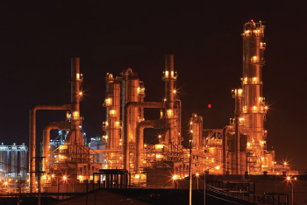
Process Types
© Ingram Publishing
© Don Tremain/Getty Images
A job shop
A batch process
© https://www.procore.com/
A project process
© Glow Images
© vichie81/123RF
A repetitive process
A continuous process

Slide 9
Process Types
 | Job Shop | Batch | Repetitive/ Assembly | Continuous
Description | Customized goods or services | Semi-standardized goods or services | Standardized goods or services | Highly standardized Goods or services
Advantages | Able to handle a wide variety of work | Flexibility; easy to add or change products or services | Low unit cost, high volume, efficient | Very efficient, very high volume
Disadvantages | Slow, high cost per unit, complex planning and scheduling | Moderate cost per unit, moderate scheduling complexity | Low flexibility, high cost of downtime | Very rigid, lack of variety, costly to change, very high cost of downtime

Slide 10
Variety and Equipment Flexibility
 | High Variety | Moderate Variety | Low Variety | Very Low Variety
Low or very low volume | Job Shop: repair shop emergency room
Moderate volume |  | Batch: commercial bakery classroom lecture
High volume |  |  | Repetitive: assembly line automatic car wash
Very high volume |  |  |  | Continuous Flow: petroleum refining water treatment

Slide 11
Process Choice and Activities
Activity/ Function | Job Shop | Batch | Repetitive/ Assembly | Continuous | Projects
Cost estimation | Difficult | Somewhat routine | Routine | Routine | Simple to complex
Cost per unit | High | Moderate | Low | Low | Very high
Equipment used | General purpose | General purpose | Special purpose | Special purpose | Varied
Fixed costs | Low | Moderate | High | Very high | Varied
Variable costs | High | Moderate | Low | Very low | High
Labor skills | High | Moderate | Low | Low to high | Low to high
Marketing | Promote capabilities | Promote capabilities; semi-standardized goods/services | Promote standardized goods/services | Promote standardized goods/services | Promote capabilities
Scheduling | Complex | Moderately complex | Routine | Routine | Complex, subject to change
WIP inventory | High | High | Low | Low | Varied

Slide 12
Facility Layout
Facility layout refers to the arrangement of activities, processes, departments, workstations, storage areas, aisles, and common areas within an existing or proposed facility.
Layout design is important because it can have a significant effect on the cost and efficiency of an operation and can entail substantial investment in time and money.
Material storage and movement are directly affected by the type of layout.

Slide 13
Objectives of Facility Layout
The basic objective of the layout decision is to ensure a smooth flow of work, material, people, and information through the system. Some others are—
Minimize movement and material handling costs;
Utilize space efficiently;
Utilize labor efficiently;
Eliminate bottlenecks;
Facilitate communication and interaction between workers, between workers and their supervisors, and between workers and customers;
Reduce manufacturing cycle time and customer service time;
Eliminate wasted or redundant movement;

Slide 14
Objectives of Facility Layout
Facilitate the entry, exit, and placement of material, products, and people;
Incorporate safety and security measures;
Promote product and service quality;
Encourage proper maintenance activities;
Provide a visual control of activities;
Provide flexibility to adapt to changing conditions;
Increase capacity.

Slide 15
Types of Layouts
Process Layout (functional layouts)
Machines grouped by process they perform
Product Layout (assembly lines)
Linear arrangement of workstations to produce a specific product
Fixed Position Layout
Used in projects where the product cannot be moved
Combination Layout
A combination of the three basic layout types

Slide 16
Process Layout
A process layout is characteristic of intermittent operations, service shops, job shops, or batch production, which serve different customers with different needs.
The volume of each customer’s order is low, and the sequence of operations required to complete a customer’s order can vary considerably.
The major layout concern for a process layout is where to locate the departments or machine centers in relation to each other.
Storage space in a process layout is large to accommodate the large amount of work-in-process inventory.

Slide 17
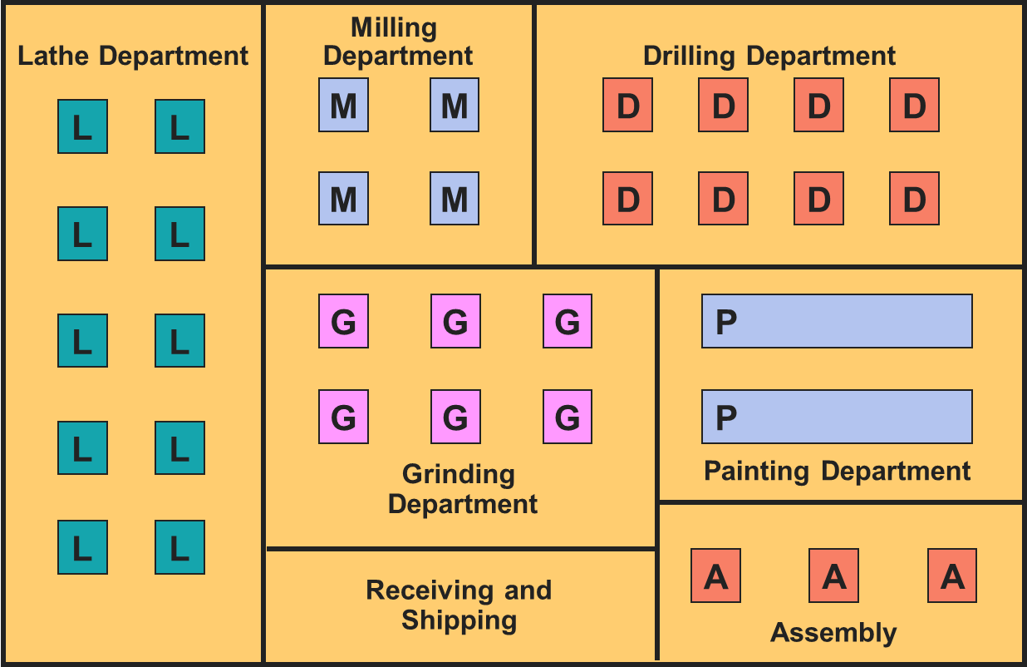
Process Layout

Slide 18
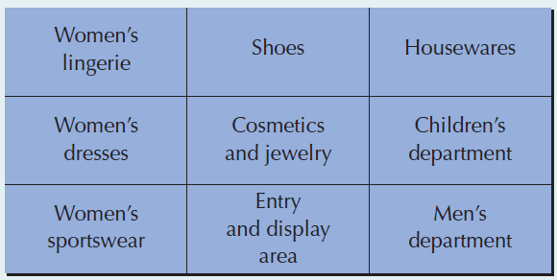
Process Layout
Example: A Process Layout
in Services

Slide 19
Product Layout
The flow of work is orderly and efficient, moving from one workstation to another down the assembly line until a finished product comes off the end of the line.
Product layouts are suitable for mass production or repetitive operations in which demand is stable and volume is high.
The major concern in a product layout is balancing the assembly line so that no one workstation becomes a bottleneck and holds up the flow of work through the line.

Slide 20
Product Layout
In
Out

Slide 21
Comparison of Product and Process Layout
 | Product Layout | Process Layout
Description | Sequential arrangement of activities | Functional grouping of activities
Type of process | Continuous, mass production, mainly assembly | Intermittent, job shop, batch production, mainly fabrication
Product | Standardized, made to stock | Varied, made to order
Demand | Stable | Fluctuating
Volume | High | Low
Equipment | Special purpose | General purpose
Workers | Limited skills | Varied skills
Inventory | Low in-process, high finished goods | High in-process, low finished goods
Storage space | Small | Large
Material handling | Fixed path (conveyor) | Variable path (forklift)
Aisles | Narrow | Wide
Scheduling | Part of balancing | Dynamic
Layout decision | Line balancing | Machine location
Goal | Equalize work at each station | Minimize material handling cost
Advantage | Efficiency | Flexibility

Slide 22
Fixed-position layouts
In a fixed position layout, all resources for producing the product, such as equipment and labor must move to the site of the product or service.
The emphasis is on the scheduling and coordination of resources to ensure that they are available in the required amounts at the required time.
The space available on the site may also constrain the amount of work activity that can take place at any one time.

Slide 23
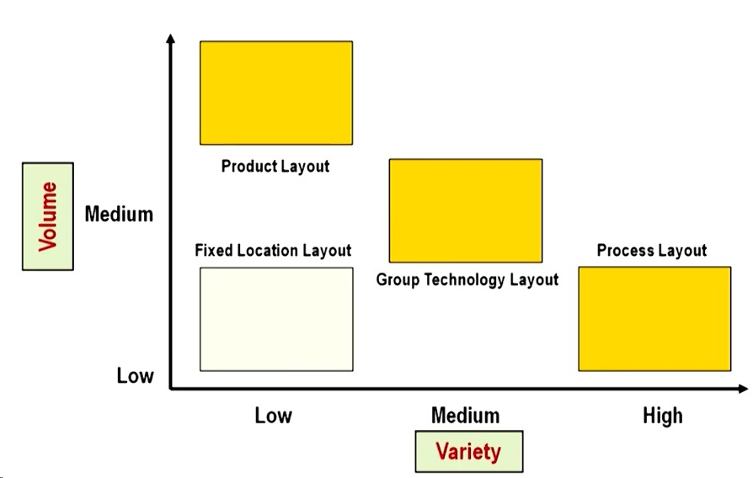
Comparison Between the Layouts

Slide 24
Quick Review
MCQ
Correct Answer: C
One of the disadvantages of a product layout is that it has:
high materials handling.
high work-in-progress inventory.
low flexibility.
low labor utilization.

Slide 25
Quick Review
MCQ
Correct Answer: B
Which of the following is a limitation of a process layout?
It affects the entire system if any equipment in the layout fails.
It has higher worker skill requirements.
It has highly specialized equipment requirements.
It generally requires a low investment for the production of machines

Slide 26
Quick Review
MCQ
Correct Answer: A
Compared to product layouts, process layouts:
require a lower investment in equipment.
provide less flexibility.
have high equipment utilization.
have less materials-handling costs.

Slide 27
Designing Process Layouts
In designing a process layout, we want to minimize movement or material handling cost, which is a function of the amount of material moved times the distance it is moved.
This implies that departments that incur the most inter-department movement should be located closest to each other, and those that do not interact should be located further away.
Two techniques used to design process layouts—
Block diagramming
Relationship diagramming

Slide 28
Block Diagraming
Construct a "from-to matrix"
Determine the space requirements
Develop an initial schematic diagram
Determine the cost of this layout
Try to improve the layout
Prepare a detailed plan
where n = total number of work centers or departments
i, j = individual departments
X_{ij} = number of loads moved from
department i to department j
C_{ij} = cost to move a load between
department i and department j

Slide 29
Block Diagramming Example 1
Arrange six departments in a factory to minimize the material handling costs. Each department is 20 x 20 feet and the building is 60 feet long and 40 feet wide.
Number of loads per week
50 100 0 0 20
30 50 10 0
20 0 100
50 0
0
Department Assembly Painting Machine Receiving Shipping Testing
(1) (2) Shop (3) (4) (5) (6)
Assembly (1)
Painting (2)
Machine Shop (3)
Receiving (4)
Shipping (5)
Testing (6)

Slide 30
Block Diagramming Example 1
Area A Area B Area C
Area D Area E Area F
Assembly Painting Machine Shop
Department Department Department
(1) (2) (3)
40'
Receiving Shipping Testing
Department Department Department
(4) (5) (6)
60'

Slide 31
Block Diagramming Example 1
Interdepartmental Flow Graph
100
Assembly
(1)
50
Painting
(2)
30
Machine Shop (3)
20
20
10
50
100
Receiving
(4)
Shipping
(5)
Testing
(6)
50

Slide 32
Block Diagramming Example 1
Cost = $50 + $200 + $40
(1 and 2) (1 and 3) (1 and 6)
+ $30 + $50 + $10
(2 and 3) (2 and 4) (2 and 5)
+ $40 + $100 + $50
(3 and 4) (3 and 6) (4 and 5)
= $570

Slide 33
Block Diagramming Example 1
Revised Interdepartmental Flow Graph
30
Painting
(2)
50
Assembly
(1)
100
Machine Shop (3)
10
20
50
20
100
Receiving
(4)
Shipping
(5)
Testing
(6)
50

Slide 34
Block Diagramming Example 1
Cost = $50 + $100 + $20
(1 and 2) (1 and 3) (1 and 6)
+ $60 + $50 + $10
(2 and 3) (2 and 4) (2 and 5)
+ $40 + $100 + $50
(3 and 4) (3 and 6) (4 and 5)
= $480

Slide 35
Block Diagramming Example 1
Area A Area B Area C
Area D Area E Area F
Painting Assembly Machine Shop
Department Department Department
(2) (1) (3)
40'
Receiving Shipping Testing
Department Department Department
(4) (5) (6)
60'

Slide 36
Process Layout Example 2
Distance between locations in meters
 |  | To
 |  | A | B | C
From | A |  | 20 | 40
 | B | 20 |  | 30
 | C | 40 | 30
Ex: The interdepartmental work flows and distance between location are given in the from of “To-From” matrixes. Please minimize the total transportation cost, if incurred cost is $2 per unit load meter.
Interdepartmental work flows (loads per day)
 |  | To
 |  | 1 | 2 | 3
From | 1 |  | 20 | 80
 | 2 | 10 |  | 30
 | 3 | 90 | 70

Slide 37
Process Layout Example 2
A
B
Existing System
170
C
1
30
2
100
3
Dept. | Loads | Location | Distance (meters) | Load Distance Score
1 to 2 | 30 | A to B | 20 | 30 × 20 = 600
1 to 3 | 170 | A to C | 40 | 170 × 40 = 6800
2 to 3 | 100 | B to C | 30 | 100 × 30 = 3,000
 |  |  | Total | 10,400
Total cost = 10,400 * 2 =$20,800

Slide 38
Process Layout Example 2
A
B
Improved System
30
C
1
170
3
100
2
Dept. | Loads | Location | Distance (meters) | Load Distance Score
1 to 3 | 170 | A to B | 20 | 170 × 20 = 3,400
1 to 2 | 30 | A to C | 40 | 30 × 40 = 1,200
2 to 3 | 100 | B to C | 30 | 100 × 30 = 3,000
 |  |  | Total | 7,600
Total cost = 7,600 * 2 =$15200

Slide 39
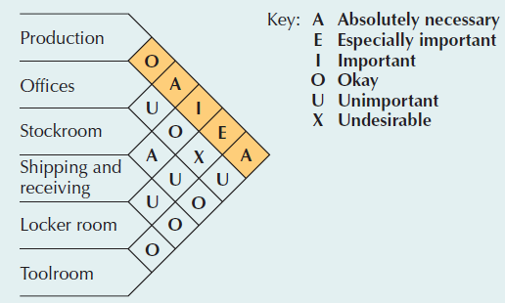
Relationship Diagramming
The preceding solution procedure is appropriate for designing process layouts when quantitative data are available.
For subjective or qualitative data, Richard Muther developed a format for displaying manager preferences for departmental locations, known as Muther’s grid
The preference information is coded into six categories associated with the five vowels, A, E, I, O, and U, plus the letter X.

Slide 40
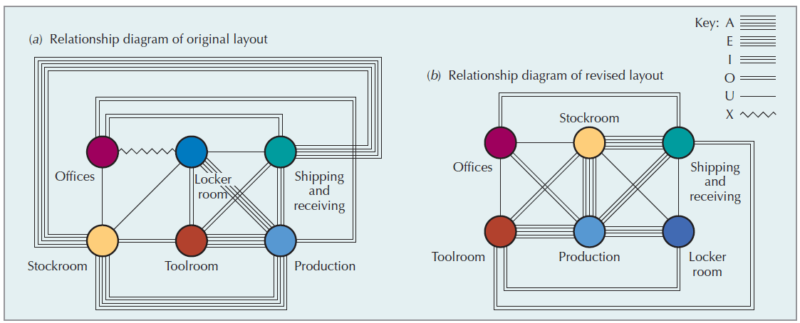
Relationship Diagramming

Slide 41
Designing product layouts
A product layout arranges machines or workers in a line according to the operations that need to be performed to assemble a particular product.
Precedence requirements specify which operations must precede others, which can be done concurrently and which must wait until later.
To attain the required output efficiently, jobs are broken down into their smallest indivisible portions, called work elements.
For the layout decision, the work elements are grouped into workstations so that products can flow smoothly.

Slide 42
Improving Product Layouts
Material
Current layout - workers in small closed areas.
Improved layout - cross-trained workers can assist each other. May be able to add a third worker as additional output is needed.

Slide 43
Improving Product Layouts
Current layout - straight lines make it hard to balance tasks because work may not be divided evenly
Improved layout - in U shape, workers have better access. Four cross-trained workers were reduced to three.
U-shaped line may reduce employee movement and space requirements while enhancing communication, reducing the number of workers, and facilitating inspection

Slide 44
Line balancing
The process of equalizing the amount of work at each workstation is called line balancing.
The main aim is to obtain task grouping that represents approximately equal time requirements. This will minimize the idle time along the line and results in a high utilization of equipment and labor.
Assembly-line balancing operates under two constraints:
Precedence requirements
Cycle time restrictions

Slide 45
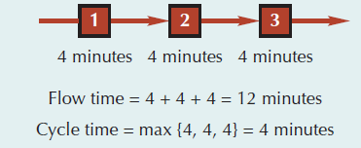
Line balancing
Cycle time example
production time available
desired units of output
C_{d} =
(8 hours x 60 minutes)
(120 units)
C_{d} =
Given
Available time = 8 Hours
Desired units of output= 120 Units
480
120
C_{d} = = 4 minutes

Slide 46
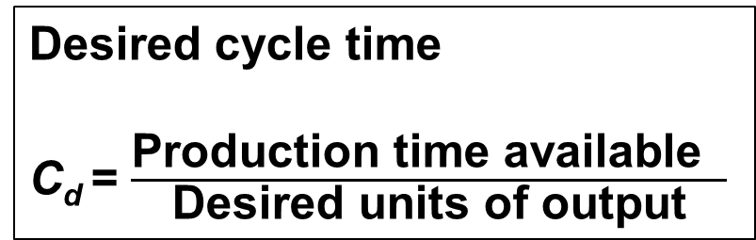
Efficiency of line
Desired cycle time
C_{d} = $\frac{\text{Production} \text{time} \text{available} }{\text{Desired} \text{units} \text{of} \text{output}}$
Minimum number
Of workstations
Efficiency
j
i = 1
j
i = 1
∑
∑
t_{i}
t_{i}
N =
E =
C_{d}
nC_{a}
Where
The actual cycle time, Ca, is the maximum workstation time on the line.
It differs from the desired cycle time when the production quota does not match the maximum output attainable by the system.
t_{i} = completion time for element i
j = number of work elements
n = actual number of workstations
C_{a} = actual cycle time
C_{d} = desired cycle time

Slide 47
Line balancing procedure
The various steps of line balancing are—
Draw and label a precedence diagram.
Calculate the desired cycle time required for the line.
Calculate the theoretical minimum number of workstations.
Group elements into workstations, recognizing cycle time and precedence constraints.
Calculate the efficiency of the line.
Determine if the theoretical minimum number of workstations or an acceptable efficiency level has been reached or not. If not, go back to step 4.

Slide 48
Example 2
WORK ELEMENT PRECEDENCE TIME (MIN)
A Press out sheet of fruit — 0.1
B Cut into strips A 0.2
C Outline fun shapes A 0.4
D Roll up and package B, C 0.3
0.2
Production time available = 40 Hrs
Desired units of output= 6000 units
B
40 hours x 60 minutes / hour
6,000 units
2400
6000
0.1
A
D
0.3
C_{d} = = = 0.4 minute
C
0.1 + 0.2 + 0.3 + 0.4
0.4
1.0
0.4
0.4
N = = = 2.5 workstations
3 workstations

Slide 49
Example 1
REMAINING REMAINING
WORKSTATION ELEMENT TIME ELEMENTS
WORK ELEMENT PRECEDENCE TIME (MIN)
A Press out sheet of fruit — 0.1
B Cut into strips A 0.2
C Outline fun shapes A 0.4
D Roll up and package B, C 0.3
1 A 0.3 B, C
1 A 0.3 B, C
B 0.1 C, D
1 A 0.3 B, C
B 0.1 C, D
2 C 0.0 D
3 D 0.1 none
0.2
C_{d} = 0.4
N = 3
B
0.1
A
D
0.3
C
0.4

Slide 50
Example 2
TABLE |  | Precedence Data for Wing Component
TASK | ASSEMBLY TIME (MINUTES) |  |  |  | PRECEDENCE REQUIREMENT
A |  |  | 10 |  | –
B |  |  | 11 |  | A
C |  |  | 5 |  | B
D |  |  | 4 |  | B
E |  |  | 11 |  | A
F |  |  | 3 |  | C, D
G |  |  | 7 |  | F
H |  |  | 11 |  | E
I |  |  | 3 |  | G, H
Total time |  |  | 65
This means that tasks B and E cannot be done until task A has been completed

Slide 51
Example 2
TABLE |  | Precedence Data for Wing Component
TASK | ASSEMBLY TIME (MINUTES) |  |  |  | PRECEDENCE REQUIREMENT
A |  |  | 10 |  | –
B |  |  | 11 |  | A
C |  |  | 5 |  | B
D |  |  | 4 |  | B
E |  |  | 11 |  | A
F |  |  | 3 |  | C, D
G |  |  | 7 |  | F
H |  |  | 11 |  | E
I |  |  | 3 |  | G, H
Total time |  |  | 65
480 available mins per day
40 units required
Production time available per day
Units required per day
Cycle time =
= 480 / 40
= 12 minutes per unit
Figure 9.12
5
5
C
C
10
11
3
7
10
11
A
3
B
7
F
G
Minimum number of workstations
A
B
F
G
4
3
4
3
11
D
11
I
D
I
11
= 65 / 12
= 5.42, or 6 stations
11
E
H
E
H

Slide 52
Example 2
480 available mins per day
40 units required
Cycle time = 12 mins
Minimum workstations
= 5.42 or 6
Station 2
5
C
10
11
3
7
A
B
F
G
4
∑ Task times
(Actual number of workstations) x (Largest cycle time)
3
Efficiency =
D
Station 3
I
Station 4
= 65 minutes / ((6 stations) x (12 minutes))
= 90.3%
11
11
Station 6
Station 1
E
H
Station 6
Idle Time = ((6 stations) × (12 minutes)) – 65 minutes = 7 minutes
Station 3
Station 5

Slide 53
Quick Review
True or False
Correct Answer: False
Process layouts require simple planning and control systems.

Slide 54
Quick Review
True or False
Correct Answer: False
Process layouts typically have low levels of work-in-process inventory.

Slide 55
Quick Review
True or False
Correct Answer: True
The most common tactic to arrange departments in a process-oriented layout is to minimize material handling costs.

Slide 56
Hybrid layouts
Hybrid layouts modify and/or combine some aspects of product and process layouts.
There are two hybrid layouts:
Cellular layouts
Flexible manufacturing systems

Slide 57
Cellular layouts
Cellular layouts attempt to combine the flexibility of a process layout with the efficiency of a product layout.
Based on the concept of group technology (GT), dissimilar machines or activities are grouped into work centers, called cells, to process families of parts or customers with similar requirements.
The cells are arranged in relation to each other so that material movement is minimized.
The layout of machines within each cell resembles a small assembly line.
Thus, line-balancing procedures, with some adjustment, can be used to arrange the machines within the cell.

Slide 58
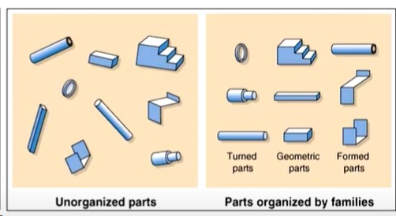
Steps in Cellular Layout
Grouping of parts into families involving a similar sequence operations.
Identification of major flow patterns to determine a basis for relocating of processes.
Developing cells by physical grouping of processes.

Slide 59
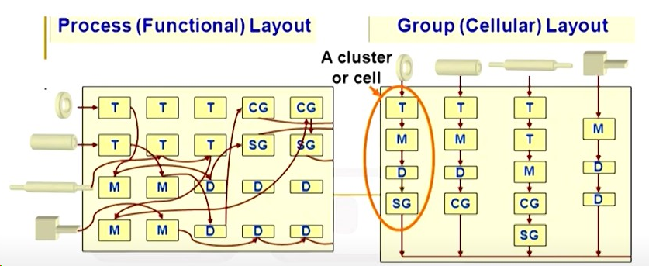
Cellular Layout Example 1

Slide 60
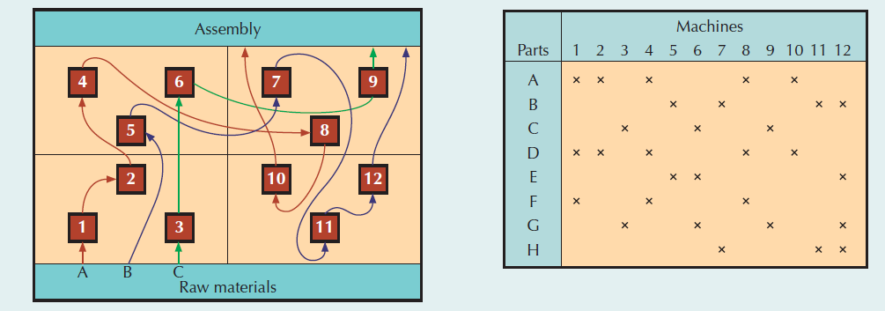
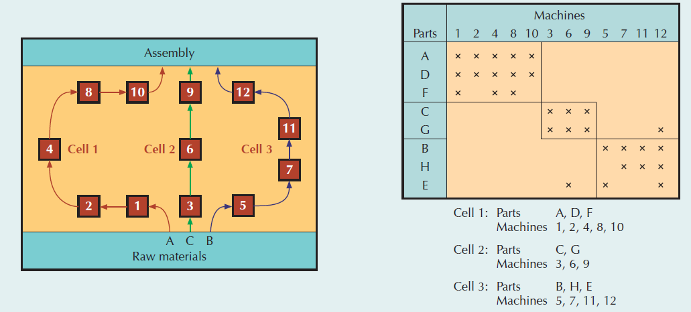
Cellular Layout Example 2
Revised
cellular layout

Slide 61
Advantages and disadvantages of Cellular Layouts
Advantages
Disadvantages
Inadequate part families
Poorly balanced cells
Expanded training and scheduling of workers
Increased capital investment
Dimension | Functional | Cellular
No. of moves between departments | Many | Few
Travel distances | Longer | Shorter
Travel paths | Variable | Fixed
Job waiting time | Greater | Shorter
Throughput time | Higher | Lower
Amount of work in process | Higher | Lower
Supervision difficulty | Higher | Lower
Scheduling complexity | Higher | Lower
Equipment utilization | Lower | Higher

Slide 62
Quick Review
True or False
Correct Answer: False
In a cellular layout, additional floor space is required because machines are not very closely linked within a cell.

Slide 63
Quick Review
MCQ
Correct Answer: D
A special arrangement of machinery and equipment to focus on production of a single product or group of related products" describes what layout type?
fixed-position layout
intermittent production
job shop layout
cellular layout

Slide 64
Quick Review
MCQ
Correct Answer: C
Which of the following is true of a cellular layout?
It remains stationary rather than moving work-in-process from one work center to another.
Its workflow is not standardized.
It is not designed according to the functional characteristics of equipment.
Its quality problems are not addressed timely.

Slide 65
Flexible Manufacturing Systems
A group of machines designed to handle intermittent processing requirements and produce a variety of similar products.
Have some of the benefits of automation and some of the flexibility of individual, or stand-alone, machines
A flexible manufacturing system (FMS) consists of numerous programmable machine tools connected by an automated material handling system, robots or other automated processing equipment and controlled by a common supervisory computer network.

Slide 66
Flexible Manufacturing Systems
Most automated production lines can produce only one type (model) of product and a change in product design would require extensive changes in the line and its equipment.
An FMS combines flexibility with efficiency.
The efficiency of an FMS is derived from reductions in setup and queue times. Setup activities take place before the part reaches the machine.
FMS layouts differ based on the variety of parts that the system can process, the size of the parts processed, and the average processing time required for part completion.

Slide 67
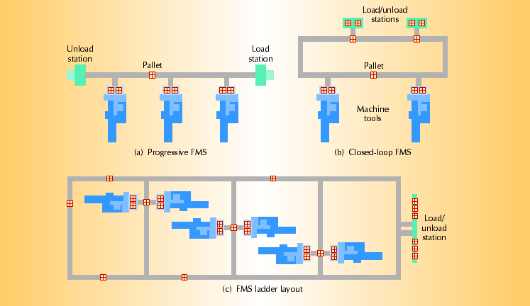
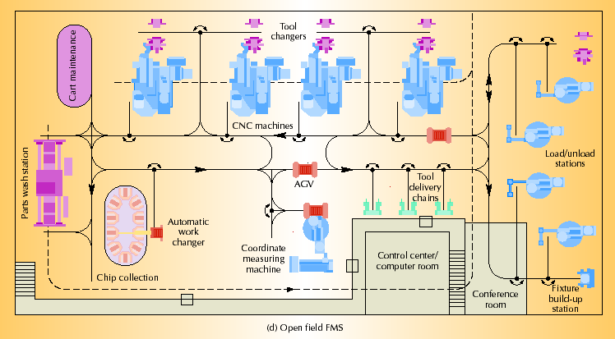
Flexible Manufacturing Systems
https://www.youtube.com/shorts/CiZGKe_hbyE

Slide 68


Thank You

